Slide 1
Divide and Conquer
Recursive in structure
Divide the problem into independent sub-problems that are similar to the original but smaller in size
Conquer the sub-problems by solving them recursively. If they are small enough, just solve them in a straightforward manner. This can be done by reducing the problem until it reaches the base case, which is the solution.
Combine the solutions of the sub-problems to create a solution to the original problem

Slide 2
Merge Sort
Sorting Problem: Sort a sequence of n elements into non-decreasing order.
Divide: Divide the n-element sequence to be sorted into two subsequences of n/2 elements each
Conquer: Sort the two subsequences recursively using merge sort.
Combine: Merge the two sorted subsequences to produce the sorted answer.

Slide 3
i=0
j=0
L
14
23
45
98
R
6
33
42
67

Slide 4
Merge
i=0
j=0
L
14
23
45
98
R
6
33
42
67
A

Slide 5
Merge
i=0
j=1
L
14
23
45
98
R
6
33
42
67
A
6
k=0

Slide 6
Merge
i=1
j=1
L
14
23
45
98
R
6
33
42
67
A
6
14
k=1

Slide 7
Merge
i=2
j=1
L
14
23
45
98
R
6
33
42
67
A
6
14
23
k=2

Slide 8
Merge
i=2
j=2
L
14
23
45
98
R
6
33
42
67
A
6
14
23
33
k=3

Slide 9
Merge
i=2
j=3
L
14
23
45
98
R
6
33
42
67
A
6
14
23
33
42
k=4

Slide 10
Merge
i=3
j=3
L
14
23
45
98
R
6
33
42
67
A
6
14
23
33
42
45
k=5

Slide 11
Merge
i=3
j=4
L
14
23
45
98
R
6
33
42
67
A
6
14
23
33
42
45
67
k=6

Slide 12
Merge
i=4
j=4
L
14
23
45
98
R
6
33
42
67
A
6
14
23
33
42
45
67
98
k=7

Slide 13
Merge(L,R,A) {
nL = length(L)
nR = length(R)
i= j = k = 0
while(i< nL && j< nR) {
if(L[i] <= R[j]) {
A[k] = L[i]
i= i+1
}
else {
A[k] = R[j]
j= j+1
}
k= k+1
}
while( i<nL) {
A[k] = L[i]; i=i+1; k=k+1;
}
while (j<nR) {
A[k] = R[i]; j=j+1; k=k+1;
}
}
n*c0+ n*c1+n*c2+ c4
=n*(c0+c1+c2) + c4
=n*c3 + c4

Slide 14
nL = length(L)
nR = length(R)
i= j = k = 0
i=0
j=0
L
14
23
45
98
R
6
33
42
67

Slide 15
while(i< nL && j< nR) {
If(L[i] <= R[j]) {
A[k] = L[i]
i= i+1
}
else {
A[k] = R[j]
j= j+1
}
k= k+1
}
i=0
j=0
L
14
23
45
98
R
6
33
42
67
A

Slide 16
while(i< nL && j< nR) {
If(L[i] <= R[j]) {
A[k] = L[i]
i= i+1
}
else {
A[k] = R[j]
j= j+1
}
k= k+1
}
i=0
j=1
L
14
23
45
98
R
6
33
42
67
A
6
k=0

Slide 17
while(i< nL && j< nR) {
If(L[i] <= R[j]) {
A[k] = L[i]
i= i+1
}
else {
A[k] = R[j]
j= j+1
}
k= k+1
}
i=1
j=1
L
14
23
45
98
R
6
33
42
67
A
6
14
k=1

Slide 18
while(i< nL && j< nR) {
If(L[i] <= R[j]) {
A[k] = L[i]
i= i+1
}
else {
A[k] = R[j]
j= j+1
}
k= k+1
}
i=2
j=1
L
14
23
45
98
R
6
33
42
67
A
6
14
23
k=2

Slide 19
while(i< nL && j< nR) {
If(L[i] <= R[j]) {
A[k] = L[i]
i= i+1
}
else {
A[k] = R[j]
j= j+1
}
k= k+1
}
i=2
j=2
L
14
23
45
98
R
6
33
42
67
A
6
14
23
33
k=3

Slide 20
while(i< nL && j< nR) {
If(L[i] <= R[j]) {
A[k] = L[i]
i= i+1
}
else {
A[k] = R[j]
j= j+1
}
k= k+1
}
i=2
j=3
L
14
23
45
98
R
6
33
42
67
A
6
14
23
33
42
k=4

Slide 21
while(i< nL && j< nR) {
If(L[i] <= R[j]) {
A[k] = L[i]
i= i+1
}
else {
A[k] = R[j]
j= j+1
}
k= k+1
}
i=3
j=3
L
14
23
45
98
R
6
33
42
67
A
6
14
23
33
42
45
k=5

Slide 22
while(i< nL && j< nR) {
If(L[i] <= R[j]) {
A[k] = L[i]
i= i+1
}
else {
A[k] = R[j]
j= j+1
}
k= k+1
}
i=3
j=4
L
14
23
45
98
R
6
33
42
67
A
6
14
23
33
42
45
67
k=6

Slide 23
while(i< nL && j< nR) {
If(L[i] <= R[j]) {
A[k] = L[i]
i= i+1
}
else {
A[k] = R[j]
j= j+1
}
k= k+1
}
i=3
j=4
L
14
23
45
98
R
6
33
42
67
A
6
14
23
33
42
45
67
k=6

Slide 24
while( i<nL) {
A[k] = L[i];
i=i+1;
k=k+1;
}
while (j<nR) {
A[k] = R[i];
j=j+1;
k=k+1;
}
i=3
j=4
L
14
23
45
98
R
6
33
42
67
A
6
14
23
33
42
45
67
k=6

Slide 25
while( i<nL) {
A[k] = L[i];
i=i+1;
k=k+1;
}
while (j<nR) {
A[k] = R[i];
j=j+1;
k=k+1;
}
i=4
j=4
L
14
23
45
98
R
6
33
42
67
A
6
14
23
33
42
45
67
98
k=7

Slide 26
Merge-Sort Tree
An execution of merge-sort is depicted by a binary tree
each node represents a recursive call of merge-sort and stores
unsorted sequence before the execution and its partition
sorted sequence at the end of the execution
the root is the initial call
the leaves are calls on subsequences of size 0 or 1
7 2 ⏐ 9 4 → 2 4 7 9
7 ⏐ 2 → 2 7
9 ⏐ 4 → 4 9
7 → 7
2 → 2
9 → 9
4 → 4
26
Notes:
26

Slide 27
Execution Example
Partition
7 2 9 4 ⏐ 3 8 6 1
2 4 7 9
1 3 6 8
1 2 3 4 6 7 8 9
27
Notes:
27

Slide 28
Execution Example
Partition
7 2 9 4 ⏐ 3 8 6 1
28
Notes:
28

Slide 29
Execution Example (cont.)
Recursive call, partition
7 2 9 4 ⏐ 3 8 6 1
7 2 ⏐ 9 4
29
Notes:
29

Slide 30
Execution Example (cont.)
Recursive call, partition
7 2 9 4 ⏐ 3 8 6 1
7 2 ⏐ 9 4
7 ⏐ 2
30

Slide 31
Execution Example (cont.)
Recursive call, base case
7 2 9 4 ⏐ 3 8 6 1
7 2 ⏐ 9 4
7 ⏐ 2
7 → 7
31

Slide 32
Execution Example (cont.)
Recursive call, base case
7 2 9 4 ⏐ 3 8 6 1
7 2 ⏐ 9 4
7 ⏐ 2
7 → 7
2 → 2
32

Slide 33
Execution Example (cont.)
Merge
7 2 9 4 ⏐ 3 8 6 1
7 2 ⏐ 9 4
7 ⏐ 2 → 2 7
7 → 7
2 → 2
33

Slide 34
Execution Example (cont.)
Recursive call, …, base case, merge
7 2 9 4 ⏐ 3 8 6 1
7 2 ⏐ 9 4
7 ⏐ 2 → 2 7
9 4 → 4 9
7 → 7
2 → 2
9 → 9
4 → 4
34

Slide 35
Execution Example (cont.)
Merge
7 2 9 4 ⏐ 3 8 6 1
7 2 ⏐ 9 4 → 2 4 7 9
7 ⏐ 2 → 2 7
9 4 → 4 9
7 → 7
2 → 2
9 → 9
4 → 4
35

Slide 36
Execution Example (cont.)
Recursive call, …, merge, merge
7 2 9 4 ⏐ 3 8 6 1
7 2 ⏐ 9 4 → 2 4 7 9
3 8 6 1 → 1 3 6 8
7 ⏐ 2 → 2 7
9 4 → 4 9
3 8 → 3 8
6 1 → 1 6
7 → 7
2 → 2
9 → 9
4 → 4
3 → 3
8 → 8
6 → 6
1 → 1
36

Slide 37
Execution Example (cont.)
Merge
7 2 9 4 ⏐ 3 8 6 1 → 1 2 3 4 6 7 8 9
7 2 ⏐ 9 4 → 2 4 7 9
3 8 6 1 → 1 3 6 8
7 ⏐ 2 → 2 7
9 4 → 4 9
3 8 → 3 8
6 1 → 1 6
7 → 7
2 → 2
9 → 9
4 → 4
3 → 3
8 → 8
6 → 6
1 → 1
37

Slide 38
Mergesort(A)
{
n = length(A)
if(n<2) return
mid = n/2
L = array of size(mid)
R = array of size(n-mid)
for(i=0; i < mid; i++)
L[i] = A[i]
for(i=mid; i < n; i++)
R[i-mid] = A[i]
Mergesort(L)
Mergesort(R)
Merge(L , R , A)
}
7 2 9 4 ⏐ 3 8 6 1 → 1 2 3 4 6 7 8 9
7 2 ⏐ 9 4 → 2 4 7 9
3 8 6 1 → 1 3 6 8
7 ⏐ 2 → 2 7
9 4 → 4 9
3 8 → 3 8
6 1 → 1 6
7 → 7
2 → 2
9 → 9
4 → 4
3 → 3
8 → 8
6 → 6
1 → 1
38

Slide 39
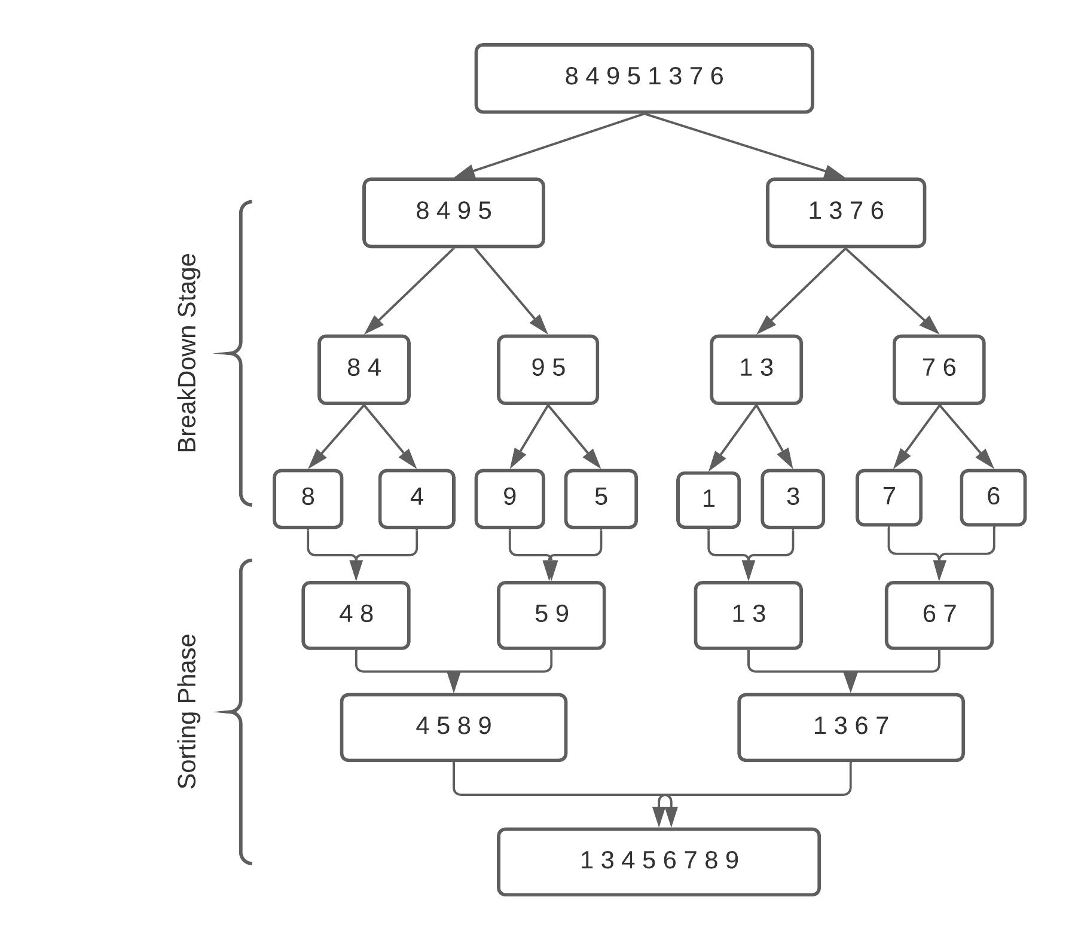

Slide 40
Merge Sort Analysis
The divide step takes constant time, regardless of the subarray size. After all, the divide step just computes the midpoint q of the indices p and r. Recall that in big-O notation, we indicate constant time by O(1).
The conquer step, where we recursively sort two subarrays of approximately n/2 elements each, takes some amount of time, but we'll account for that time when we consider the subproblems.
The combine step merges a total of n elements, taking O(n) time.

Slide 41
Merge Sort Analysis
Substitution Method

Slide 42
Mergesort(A) { | T(n), to sort n elements
n = length(A) if(n<2) return mid = n/2 L = array of size(mid) R = array of size(n-mid) | c1
for(i=0; i < mid; i++) L[i] = A[i] for(i=mid; i < n; i++) R[i-mid] = A[i] | c2* (n/2) + c2* (n/2) =c2( n/2 + n/2) =c2 * n
Mergesort(L) | T(n/2)
Mergesort(R) | T(n/2)
Merge(L , R , A) | c3.n+c4
}
So, T(n) = O(1) when n = 1, and 2T(n/2) + (c2+c3)*n + (c1+c4) when n > 1

Slide 43
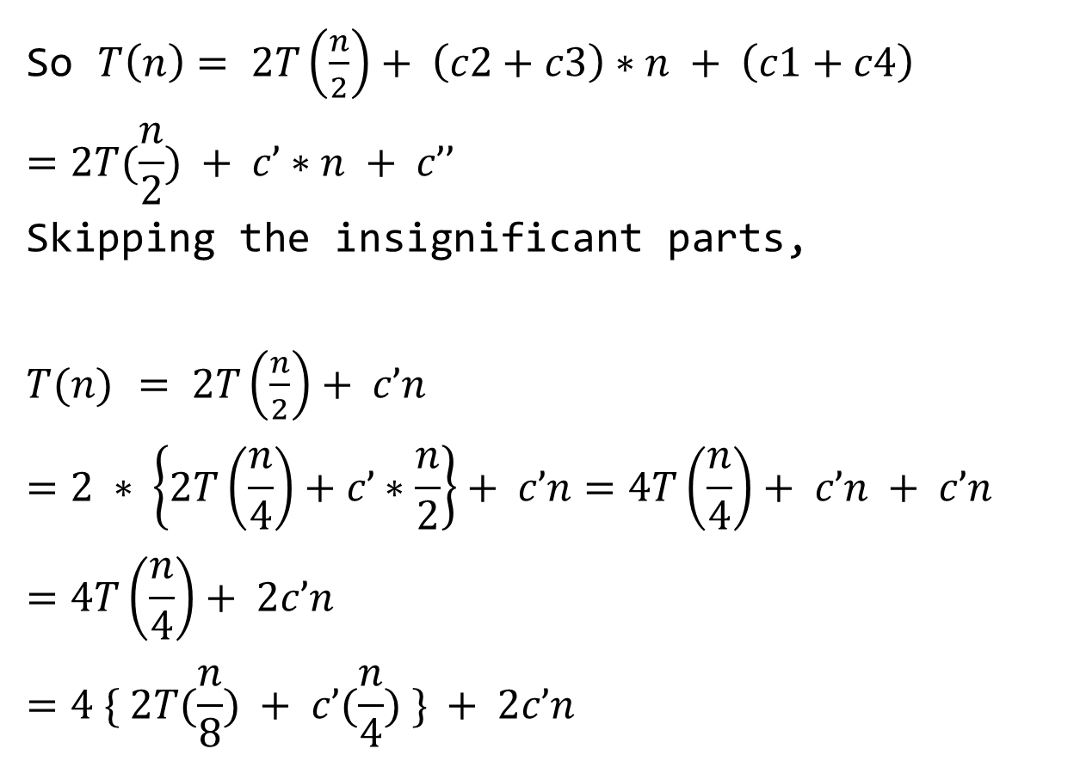
So $T\left(n\right)= 2T\left(\frac{n}{2}\right)+ \left(c2+c3\right)∗n + \left(c1+c4\right)$
$$=2T(\frac{n}{2}) + c’∗n + c’’$$
Skipping the insignificant parts,
$T(n)$ $= 2T\left(\frac{n}{2}\right)+ c’n$
$$=2 ∗ \left\{2T\left(\frac{n}{4}\right)+c’∗\frac{n}{2}\right\}+ c’n=4T\left(\frac{n}{4}\right)+ c’n + c’n$$
$$=4T\left(\frac{n}{4}\right)+ 2c’n$$
$$=4 \{ 2T(\frac{n}{8}) + c’(\frac{n}{4}) \} + 2c’n$$

Slide 44
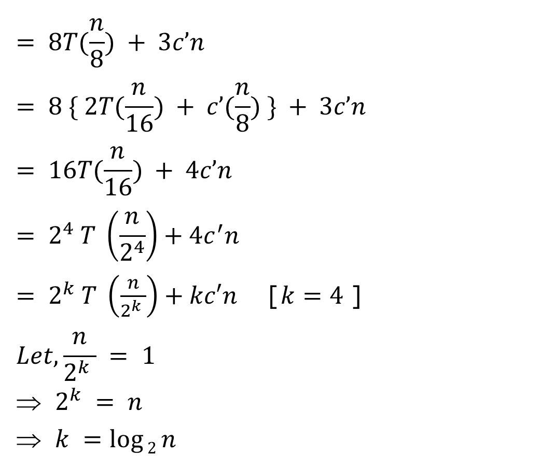
$$= 8T(\frac{n}{8}) + 3c’n$$
$$= 8 \{ 2T(\frac{n}{16}) + c’(\frac{n}{8}) \} + 3c’n= 16T(\frac{n}{16}) + 4c’n$$
$$= 2^{4} T \left(\frac{n}{2^{4}}\right)+4c^{′}n$$
$= 2^{k} T \left(\frac{n}{2^{k} }\right)+kc′n$ [$k=4$]
$$Let, \frac{n}{2^{k} } = 1$$
$2^{k} = n$
$k =\log{2}n$

Slide 45
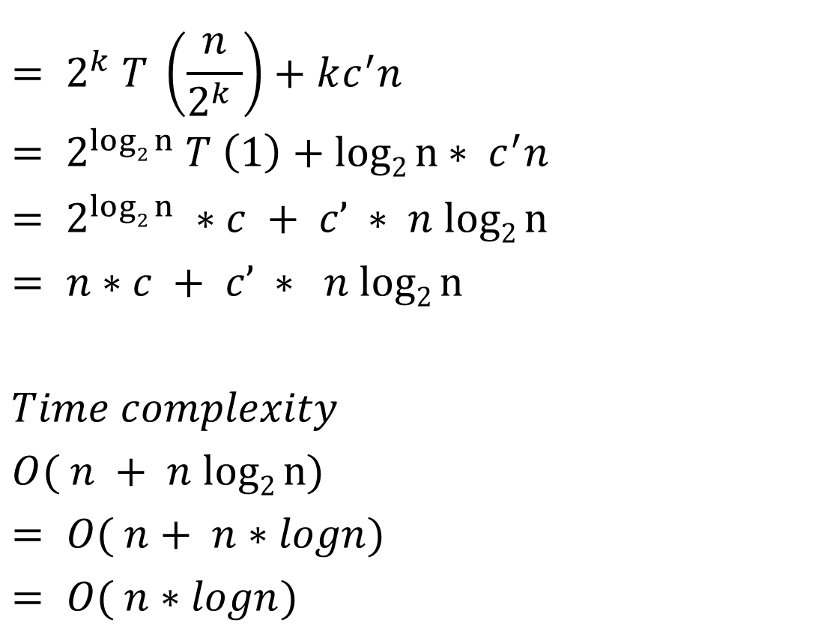
$$= 2^{k} T \left(\frac{n}{2^{k} }\right)+kc^{′}n$$
$$= 2^{log2 n} T \left(1\right)+log2 n∗ c^{′}n$$
$$= 2^{log2 n} ∗c + c’ ∗ n log2 n= n∗c + c’ ∗ n log2 n$$
$$Time complexity$$
$$O( n + n log2 n)$$
$$= O( n+ n∗logn)$$
$$= O( n∗logn)$$

Slide 46
Merge Sort Analysis
Recursion Tree Method

Slide 47
Recursion-tree Method
Recursion Trees
Show successive expansions of recurrences using trees.
Keep track of the time spent on the subproblems of a divide and conquer algorithm.
Help organize the algebraic bookkeeping necessary to solve a recurrence.

Slide 48
Recursion Tree for Merge Sort
For the original problem, we have a cost of cn, plus two subproblems each of size (n/2) and running time T(n/2).
Each of the size n/2 problems has a cost of cn/2 plus two subproblems, each costing T(n/4).
cn
cn
Cost of divide and merge.
cn/2
cn/2
T(n/2)
T(n/2)
T(n/4)
T(n/4)
T(n/4)
T(n/4)
Cost of sorting subproblems.

Slide 49
Recursion Tree for Merge Sort
Continue expanding until the problem size reduces to 1.
cn
Each level has total cost cn.
Each time we go down one level, the number of subproblems doubles, but the cost per subproblem halves ⇒ cost per level remains the same.
There are lg n + 1 levels, height is lg n. (Assuming n is a power of 2.)
Total cost = sum of costs at each level = (lg n + 1)cn = cnlgn + cn = O(n lgn).
cn/2
cn/2
cn/4
cn/4
cn/4
cn/4
c
c
c
c
c
c

Slide 50


Recursion Tree for Merge Sort
n
$$\frac{n}{2}$$
$$\frac{n}{2}$$
c.n

Slide 51
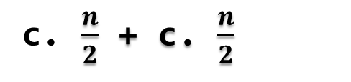




n
$$\frac{n}{2}$$
$$\frac{n}{2}$$
c.n
$$\frac{n}{4}$$
$$\frac{n}{4}$$
$$\frac{n}{4}$$
$$\frac{n}{4}$$
c. $\frac{n}{2}$ + c. $\frac{n}{2}$
=c.n
Each level has total cost c*n.
Each time we go down one level, the number of subproblems doubles, but the cost per subproblem halves ⇒ cost per level remains the same.

Slide 52
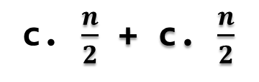


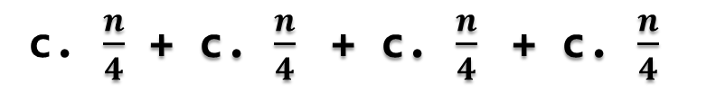





n
$$\frac{n}{2}$$
$$\frac{n}{2}$$
c.n
$$\frac{n}{4}$$
$$\frac{n}{4}$$
$$\frac{n}{4}$$
$$\frac{n}{4}$$
c. $\frac{n}{2}$ + c. $\frac{n}{2}$
=c.n
$$\frac{n}{8}$$
$$\frac{n}{8}$$
$$\frac{n}{8}$$
$$\frac{n}{8}$$
$$\frac{n}{8}$$
$$\frac{n}{8}$$
$$\frac{n}{8}$$
$$\frac{n}{8}$$
c. $\frac{n}{4}$ + c. $\frac{n}{4}$ + c. $\frac{n}{4}$ + c. $\frac{n}{4}$
=c.n

Slide 53
n
$$\frac{n}{2}$$
$$\frac{n}{2}$$
c.n
$$\frac{n}{4}$$
$$\frac{n}{4}$$
$$\frac{n}{4}$$
$$\frac{n}{4}$$
=c.n
$$\frac{n}{8}$$
$$\frac{n}{8}$$
$$\frac{n}{8}$$
$$\frac{n}{8}$$
$$\frac{n}{8}$$
$$\frac{n}{8}$$
$$\frac{n}{8}$$
$$\frac{n}{8}$$
=c.n

Slide 54







n=8
$$\frac{n}{2}$$
$$\frac{n}{2}$$
c.n
$$\frac{n}{4}$$
$$\frac{n}{4}$$
$$\frac{n}{4}$$
$$\frac{n}{4}$$
=c.n
$$\frac{8}{8}$$
$$\frac{8}{8}$$
$$\frac{8}{8}$$
$$\frac{8}{8}$$
$$\frac{8}{8}$$
$$\frac{8}{8}$$
$$\frac{8}{8}$$
$$\frac{8}{8}$$
=c.n

Slide 55







n=8
$$\frac{n}{2}$$
$$\frac{n}{2}$$
=c.n
$$\frac{n}{4}$$
$$\frac{n}{4}$$
$$\frac{n}{4}$$
$$\frac{n}{4}$$
=c.n
$\frac{8}{8}$=1
$\frac{8}{8}$=1
$\frac{8}{8}$=1
$\frac{8}{8}$=1
$\frac{8}{8}$=1
$\frac{8}{8}$=1
$\frac{8}{8}$=1
$\frac{8}{8}$=1
=c.n
So , if n=8 we need 3cn
Continue expanding until the problem size reduces to 1.

Slide 56
n=8 | 3 levels | we need 3.cn
n=16 | 4 levels | we need 4.cn
n=32 | 5 levels | we need 5.cn
n=64 | 6 levels | we need 6.cn

Slide 57
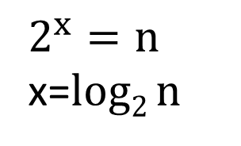
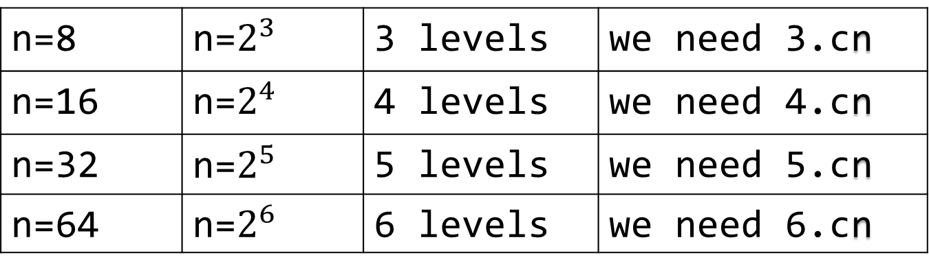
n=8 | n=$2^{3}$ | 3 levels | we need 3.cn
n=16 | n=$2^{4}$ | 4 levels | we need 4.cn
n=32 | n=$2^{5}$ | 5 levels | we need 5.cn
n=64 | n=$2^{6}$ | 6 levels | we need 6.cn
$$2^{x}=n$$
x=$log2 n$

Slide 58
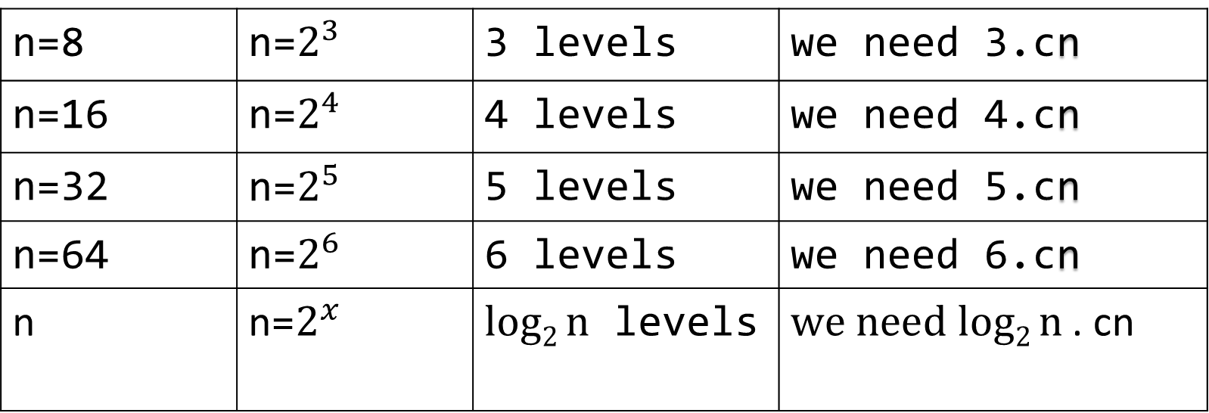
n=8 | n=$2^{3}$ | 3 levels | we need 3.cn
n=16 | n=$2^{4}$ | 4 levels | we need 4.cn
n=32 | n=$2^{5}$ | 5 levels | we need 5.cn
n=64 | n=$2^{6}$ | 6 levels | we need 6.cn
n | n=$2^{x}$ | $log2 n$ levels | $we need log2 n$ . cn

Slide 59
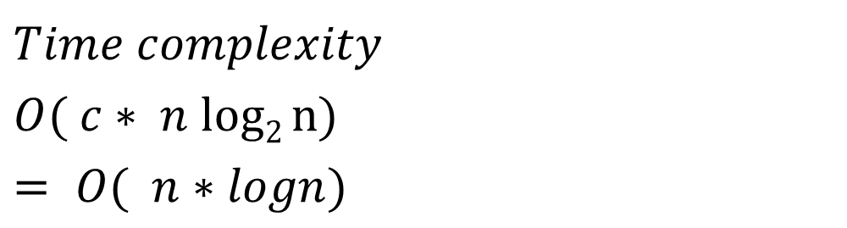
$$Time complexity$$
$$O( c∗ n log2 n)$$
$$= O( n∗logn)$$

Slide 60
Merge Sort Analysis
Master Method

Slide 61
The master method applies to recurrences of the form
T(n) = a T(n/b) + f (n) ,
where a ≥ 1, b > 1, and f is asymptotically positive.

Slide 62
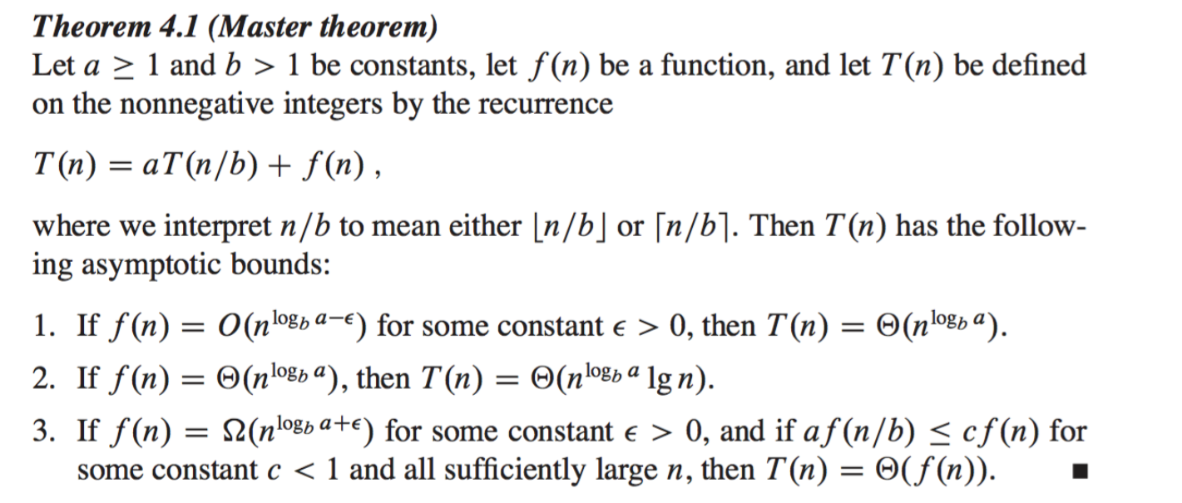

Slide 63
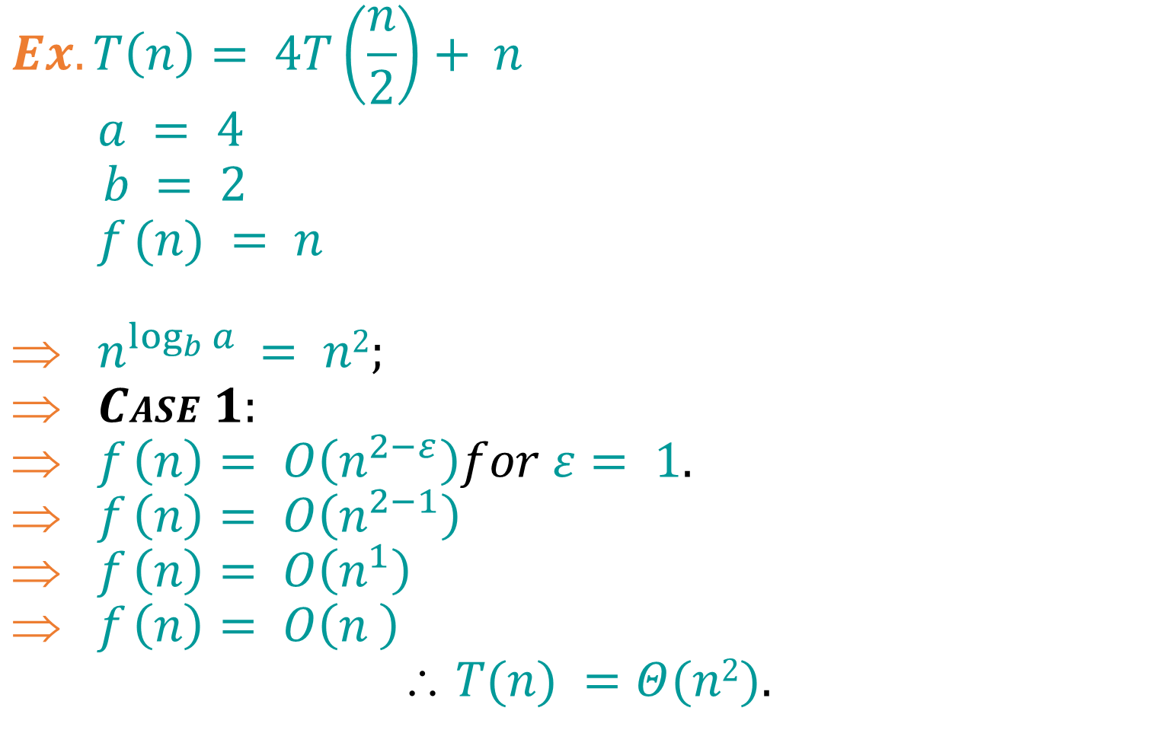
Examples:
$$Ex. T\left(n\right)= 4T\left(\frac{n}{2}\right)+ n$$
$$a = 4$$
$b = 2$
$$f (n) = n$$
$n^{\log_{b}{a}} = n2;$
$CASE 1:$
$f \left(n\right)= O\left(n^{2−ε}\right)for ε= 1.$
$f \left(n\right)= O\left(n^{2−1}\right)$
$f \left(n\right)= O\left(n^{1}\right)$
$f \left(n\right)= O\left(n^{ }\right)$
$$ T(n) =Θ(n2).$$

Slide 64
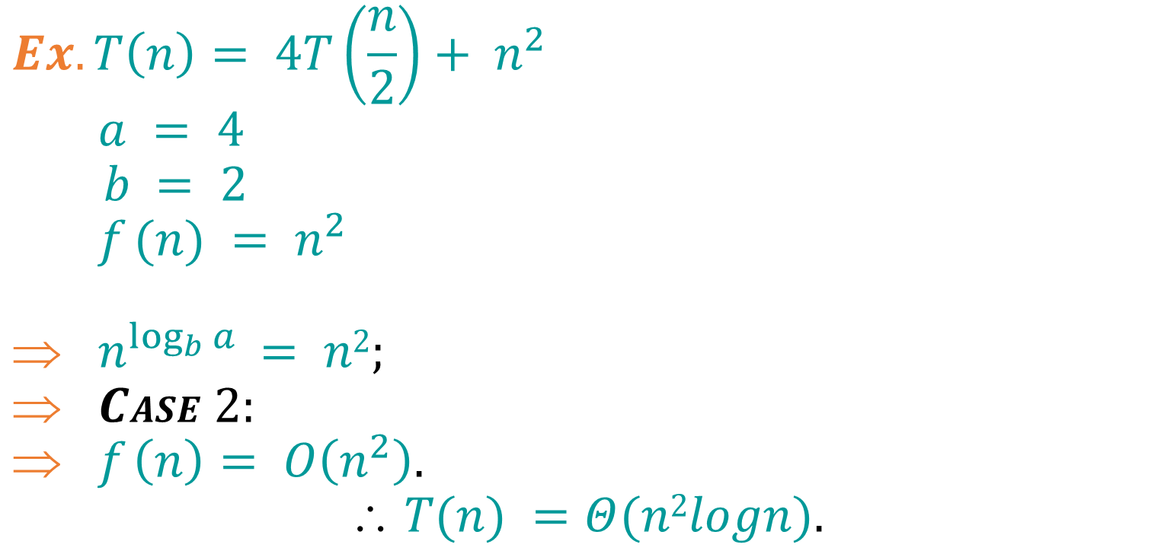
Examples:
$$Ex. T\left(n\right)= 4T\left(\frac{n}{2}\right)+ n^{2}$$
$$a = 4$$
$b = 2$
$$f (n) = n^{2}$$
$n^{\log_{b}{a}} = n2;$
$CASE 2:$
$f \left(n\right)= O\left(n^{2}\right).$
$$ T(n) =Θ(n2logn).$$

Slide 65

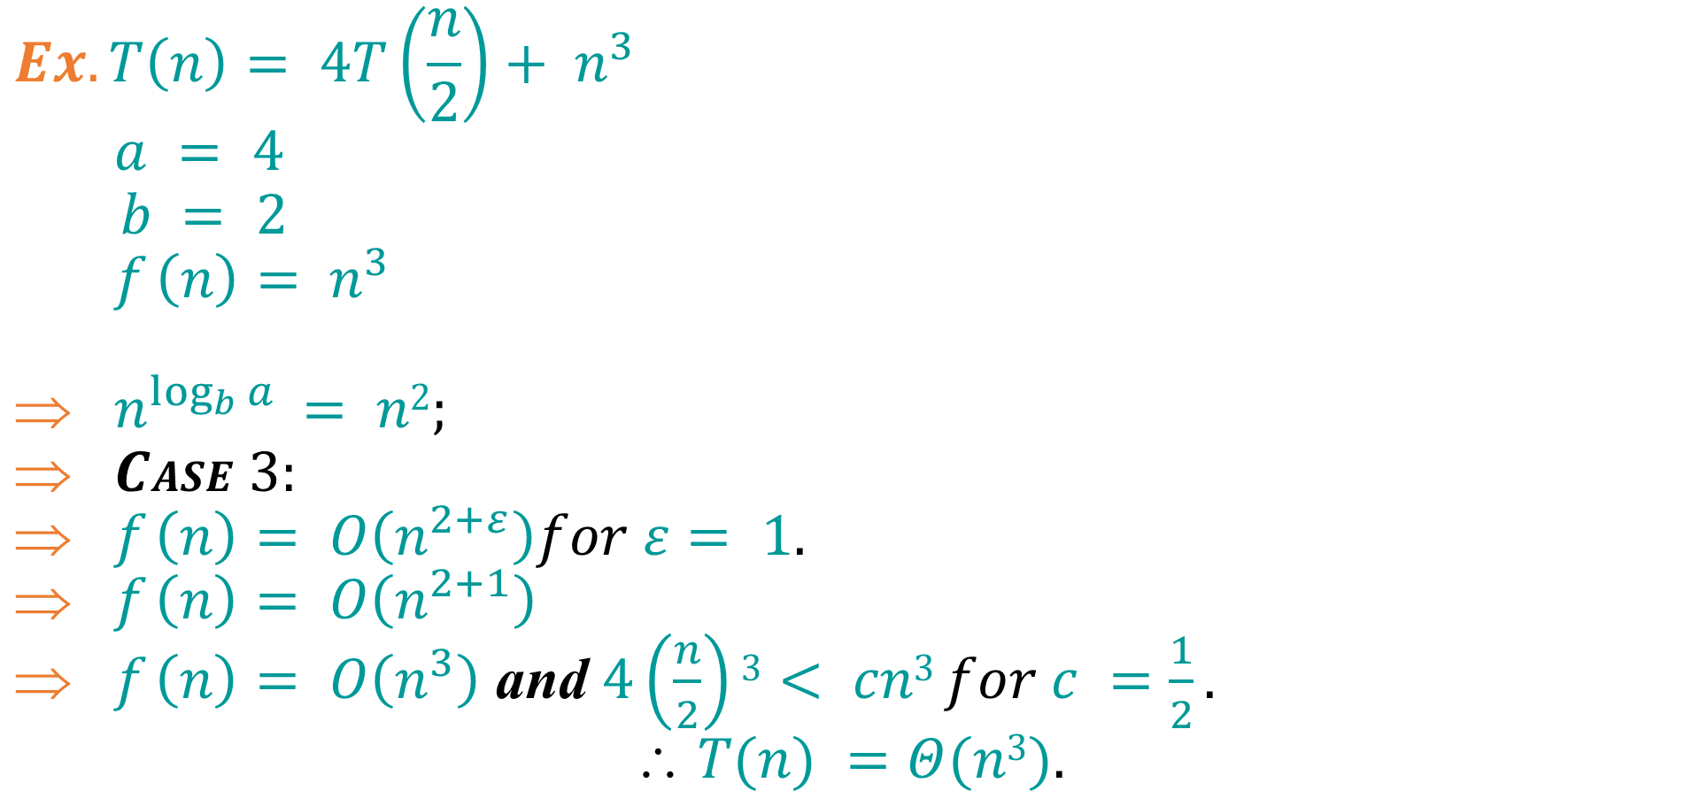
Examples:
$$Ex. T\left(n\right)= 4T\left(\frac{n}{2}\right)+ n^{3}$$
$$a = 4$$
$b = 2$
$$f \left(n\right)= n^{3}$$
$n^{\log_{b}{a}} = n2;$
$CASE 3:$
$f \left(n\right)= O\left(n^{2+ε}\right)for ε= 1.$
$f \left(n\right)= O\left(n^{2+1}\right)$
$f \left(n\right)= O\left(n^{3}\right)$ and $4\left(\frac{n}{2}\right)3< cn3 for c =\frac{1}{2}.$
$$ T(n) =Θ(n3).$$

Slide 66

Examples:
$$Ex. T\left(n\right)= 4T\left(\frac{n}{2}\right)+\frac{n^{2}}{logn}$$
$$a = 4$$
$b = 2$
$$f (n) =\frac{n^{2}}{logn}$$
$n^{\log_{b}{a}} = n2;$
$CASE 2:$
$f \left(n\right)=\frac{n^{2}}{logn}.$
$$Master method does not apply$$

Slide 67
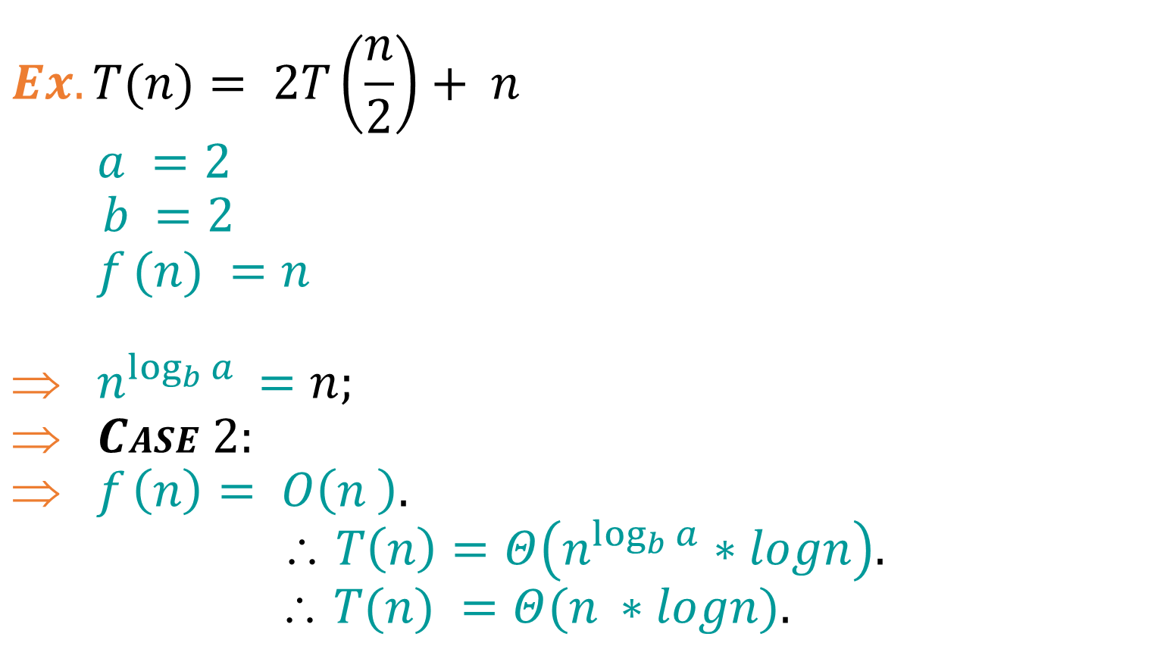
Examples(Merge Sort):
$$Ex.T(n)= 2T\left(\frac{n}{2}\right)+ n$$
$$a =2$$
$b =2$
$$f (n) =n$$
$n^{\log_{b}{a}} =n;$
$CASE 2:$
$f \left(n\right)= O\left(n^{ }\right).$
$$ T\left(n\right)=Θ\left(n^{\log_{b}{a}}∗logn\right).$$
$$ T(n) =Θ(n^{ }∗logn).$$

Slide 68
Best Case Time Complexity: O(n*log n)
Worst Case Time Complexity: O(n*log n)
Average Time Complexity: O(n*log n)
The time complexity of MergeSort is O(n*Log n) in all the 3 cases (worst, average and best) as the mergesort always divides the array into two halves and takes linear time to merge two halves.

